Slide 1
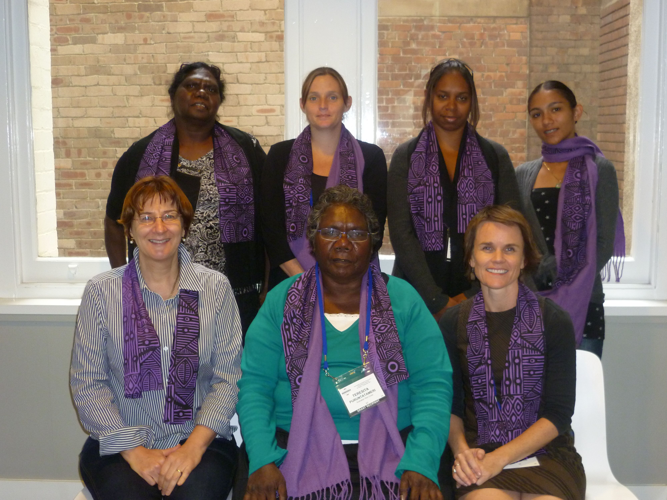
STRENGTHENING COMMUNITY DECISION MAKING THROUGH BUILDING EVALUATION CAPACITY AND PARTICIPATORY EVALUATION OF LOCAL PROGRAMS
Presentation at the AES International Conference, Sydney 2011
By the Palmerston and Tiwi Islands Communities for Children evaluation team members
Teresita Puruntatameri, Therese Puruntatameri, Narelle Calma, Stacey Dodd, Natasha Pratt, Rachel Dunne, Nea Harrison

Slide 2
Background
The Australian Red Cross NT manages the Palmerston and Tiwi islands Communities for Children (C4C) sites
Long term commitment to building the evaluation capacity of Local C4C Committee members as a way to
strengthen community decision-making
increase the quality of programs
Programs are more responsive to community needs
The design of the Program was influenced by:
extensive community consultation with Tiwi people to plan the new program
results of the Evaluation of the first C4C Program in Tiwi Islands and Palmerston
Notes:
Rachel and Teresita
The Australian Red Cross NT manages the Palmerston and Tiwi islands sites for the Communities for Children Activity
Commitment to build the evaluation capacity of the Communities for Children (C4C) Local Committee members as a way to strengthen community decision-making and increase the quality of C4C programs.
The aim is for Agencies to provide programs for children and families that are more responsive to local needs and accountable to local people as a result of greater local involvement and careful examination of the programs
The design of the Program was influenced by:
the results of the Evaluation of the first C4C Program in Tiwi Islands and Palmerston and
feedback from extensive consultation with people on Tiwi Islands during the planning stage of the new program

Slide 3
The Model
Establish and support local committees and a Joint committee to make decisions
To build local decision making capacity and
Ensure community input to decisions made about what programs to fund and how to deliver them
Employ local people in key roles
Nimarra Worker Coordinator
Nimarra workers from each Tiwi Islands communities support the ARC
Palmerston Project Officers
Contract an evaluator to train and work with local evaluation teams long term
and with community Partners to support their monitoring and review activities
Notes:
Joan
Establish and support local committees and a Joint committee to make decisions
To build local decision making capacity and
Ensure community input to decisions made about what programs to fund and how to deliver them
Employ local people in key roles
Nimarra workers from each Tiwi Islands communities support the ARC
Nimarra worker coordinator
Palmerston Project Officers
Employ an evaluator to train and work with local evaluation teams
Works with Local Committee and interested community members to build their evaluation skills and evaluate the programs conducted in their communities
Works with community Partners to support their monitoring and review activities

Slide 4
Overview of Palmerston
Fast growing satellite city 20 kilometres south of Darwin
Population of 35,00
a very young and mobile population
children aged 0-4 years make up 30% of the population
the Indigenous community is 11% of population
20% of families have one parent
There are lot of services in Palmerston, but
limited fun activities for children
Notes:
Tash and Stacey
Fast growing satellite city 20 kilometres south of Darwin
Population of 35,00
a very young and mobile population (Median age is 28)
children aged 0-4 years make up 30% of the population
the Indigenous community is 11% of population
20% of families have one parent
There are lot of services in Palmerston, but
limited fun activities for children

Slide 5
Overview of the Tiwi islands
Wurrumiyanga (Nguiu) on Bathurst Island
A former Catholic mission
Pirlangimpi and Milikapiti on Melville Island
Pirlangimpi established as a mission for part Aboriginal Children
80 kilometres north of Darwin by air or boat
Population around 2,600 Aboriginal people
The Tiwi islands communities are welcoming and friendly places
famous for football, art and great fishing
Despite a large number of children’s services working in the Tiwi Island communities, there are limited play and recreation activities and places for children and young people

Slide 6
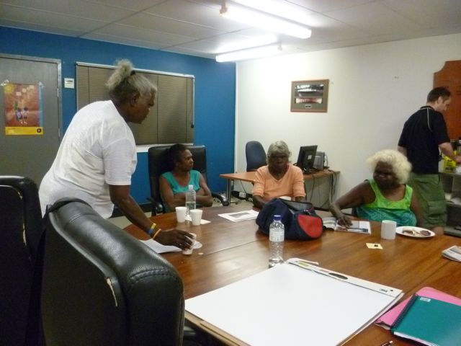
What we have been doing?

Slide 7
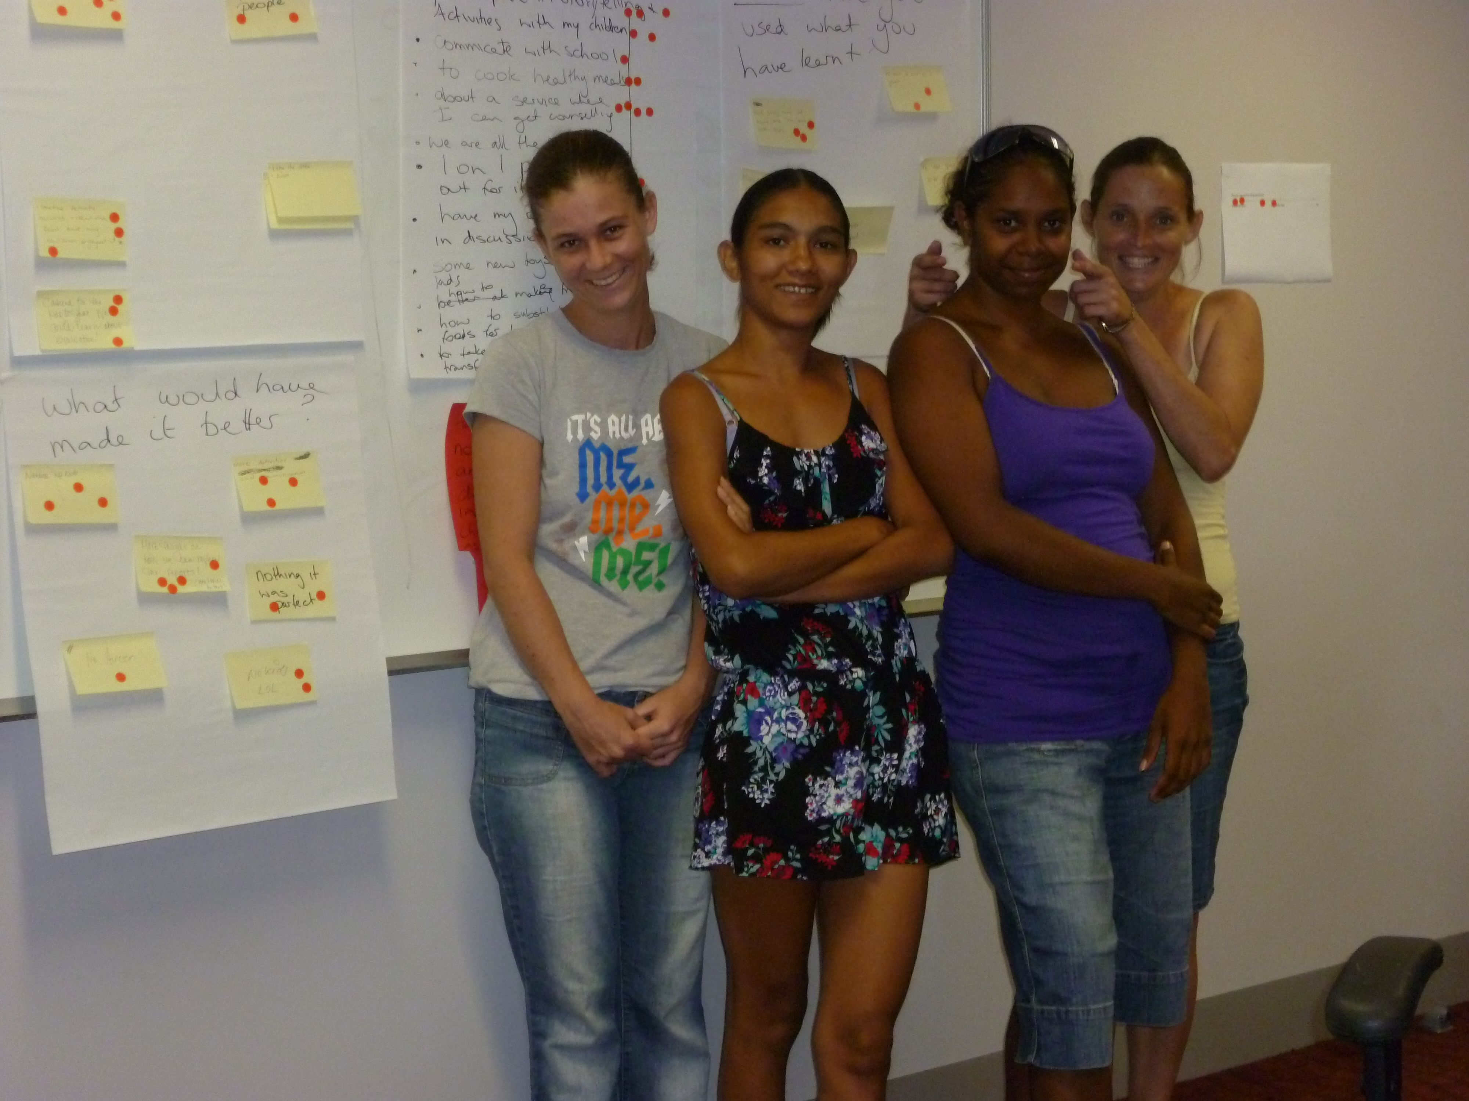
Learning about evaluation
Notes:
Workshops and training on Tiwi Islands and Palmerston to:
Learn about:
the C4C Program
what evaluation is
what we can achieve by looking at the Activities held in the local community
Plan our evaluation activities
Committee members attended the training and planning workshops run for Community Partners in Darwin so we know what they are doing

Slide 8
Evaluating C4C Programs on Tiwi Islands and in Palmerston
Notes:
Observed the C4C Activities (or participated in them)
Held community workshops to talk about the programs.
We invited C4C Activity coordinators to come to these and discuss their programs with community members
Interviewed community people, health service and school staff to find out what is working well with the Activities, what needs to be improved and what outcomes can be seen for families and children
Talked regularly to our families and community members about how the Activities are going
Got together after all the evaluation work to review what we have learnt and plan what we will report back to the community and the management committees

Slide 9
Reporting and feedback
Feedback to people we talked to
We have given feedback to everyone who talked to us
We give back workshop reports with photos in Palmerston
We give back newsletters with photos in Tiwi Islands
Feedback to community
Meetings in the community to feedback what we have learnt
Feedback to Local and Joint Committees
We report to the committee meetings and provide advice when the committees are deciding which programs to support and how to allocate funds
Notes:
Feedback to people we talked to
We have given feedback to everyone who talked to us
We give back workshop reports with photos in Palmerston
We give back newsletters with photos in Tiwi Islands
Feedback to community
Meetings in the community to feedback what we have learnt
Feedback to Local and Joint Committees
We report to the committee meetings and provide advice when the committees are deciding which programs to support and how to allocate funds

Slide 10
Feedback to committees and community
Joint committee meeting
Community feedback in Wurrumiyanga

Slide 11
Committees make decisions
about what programs to:
support
fund and
change

Slide 12
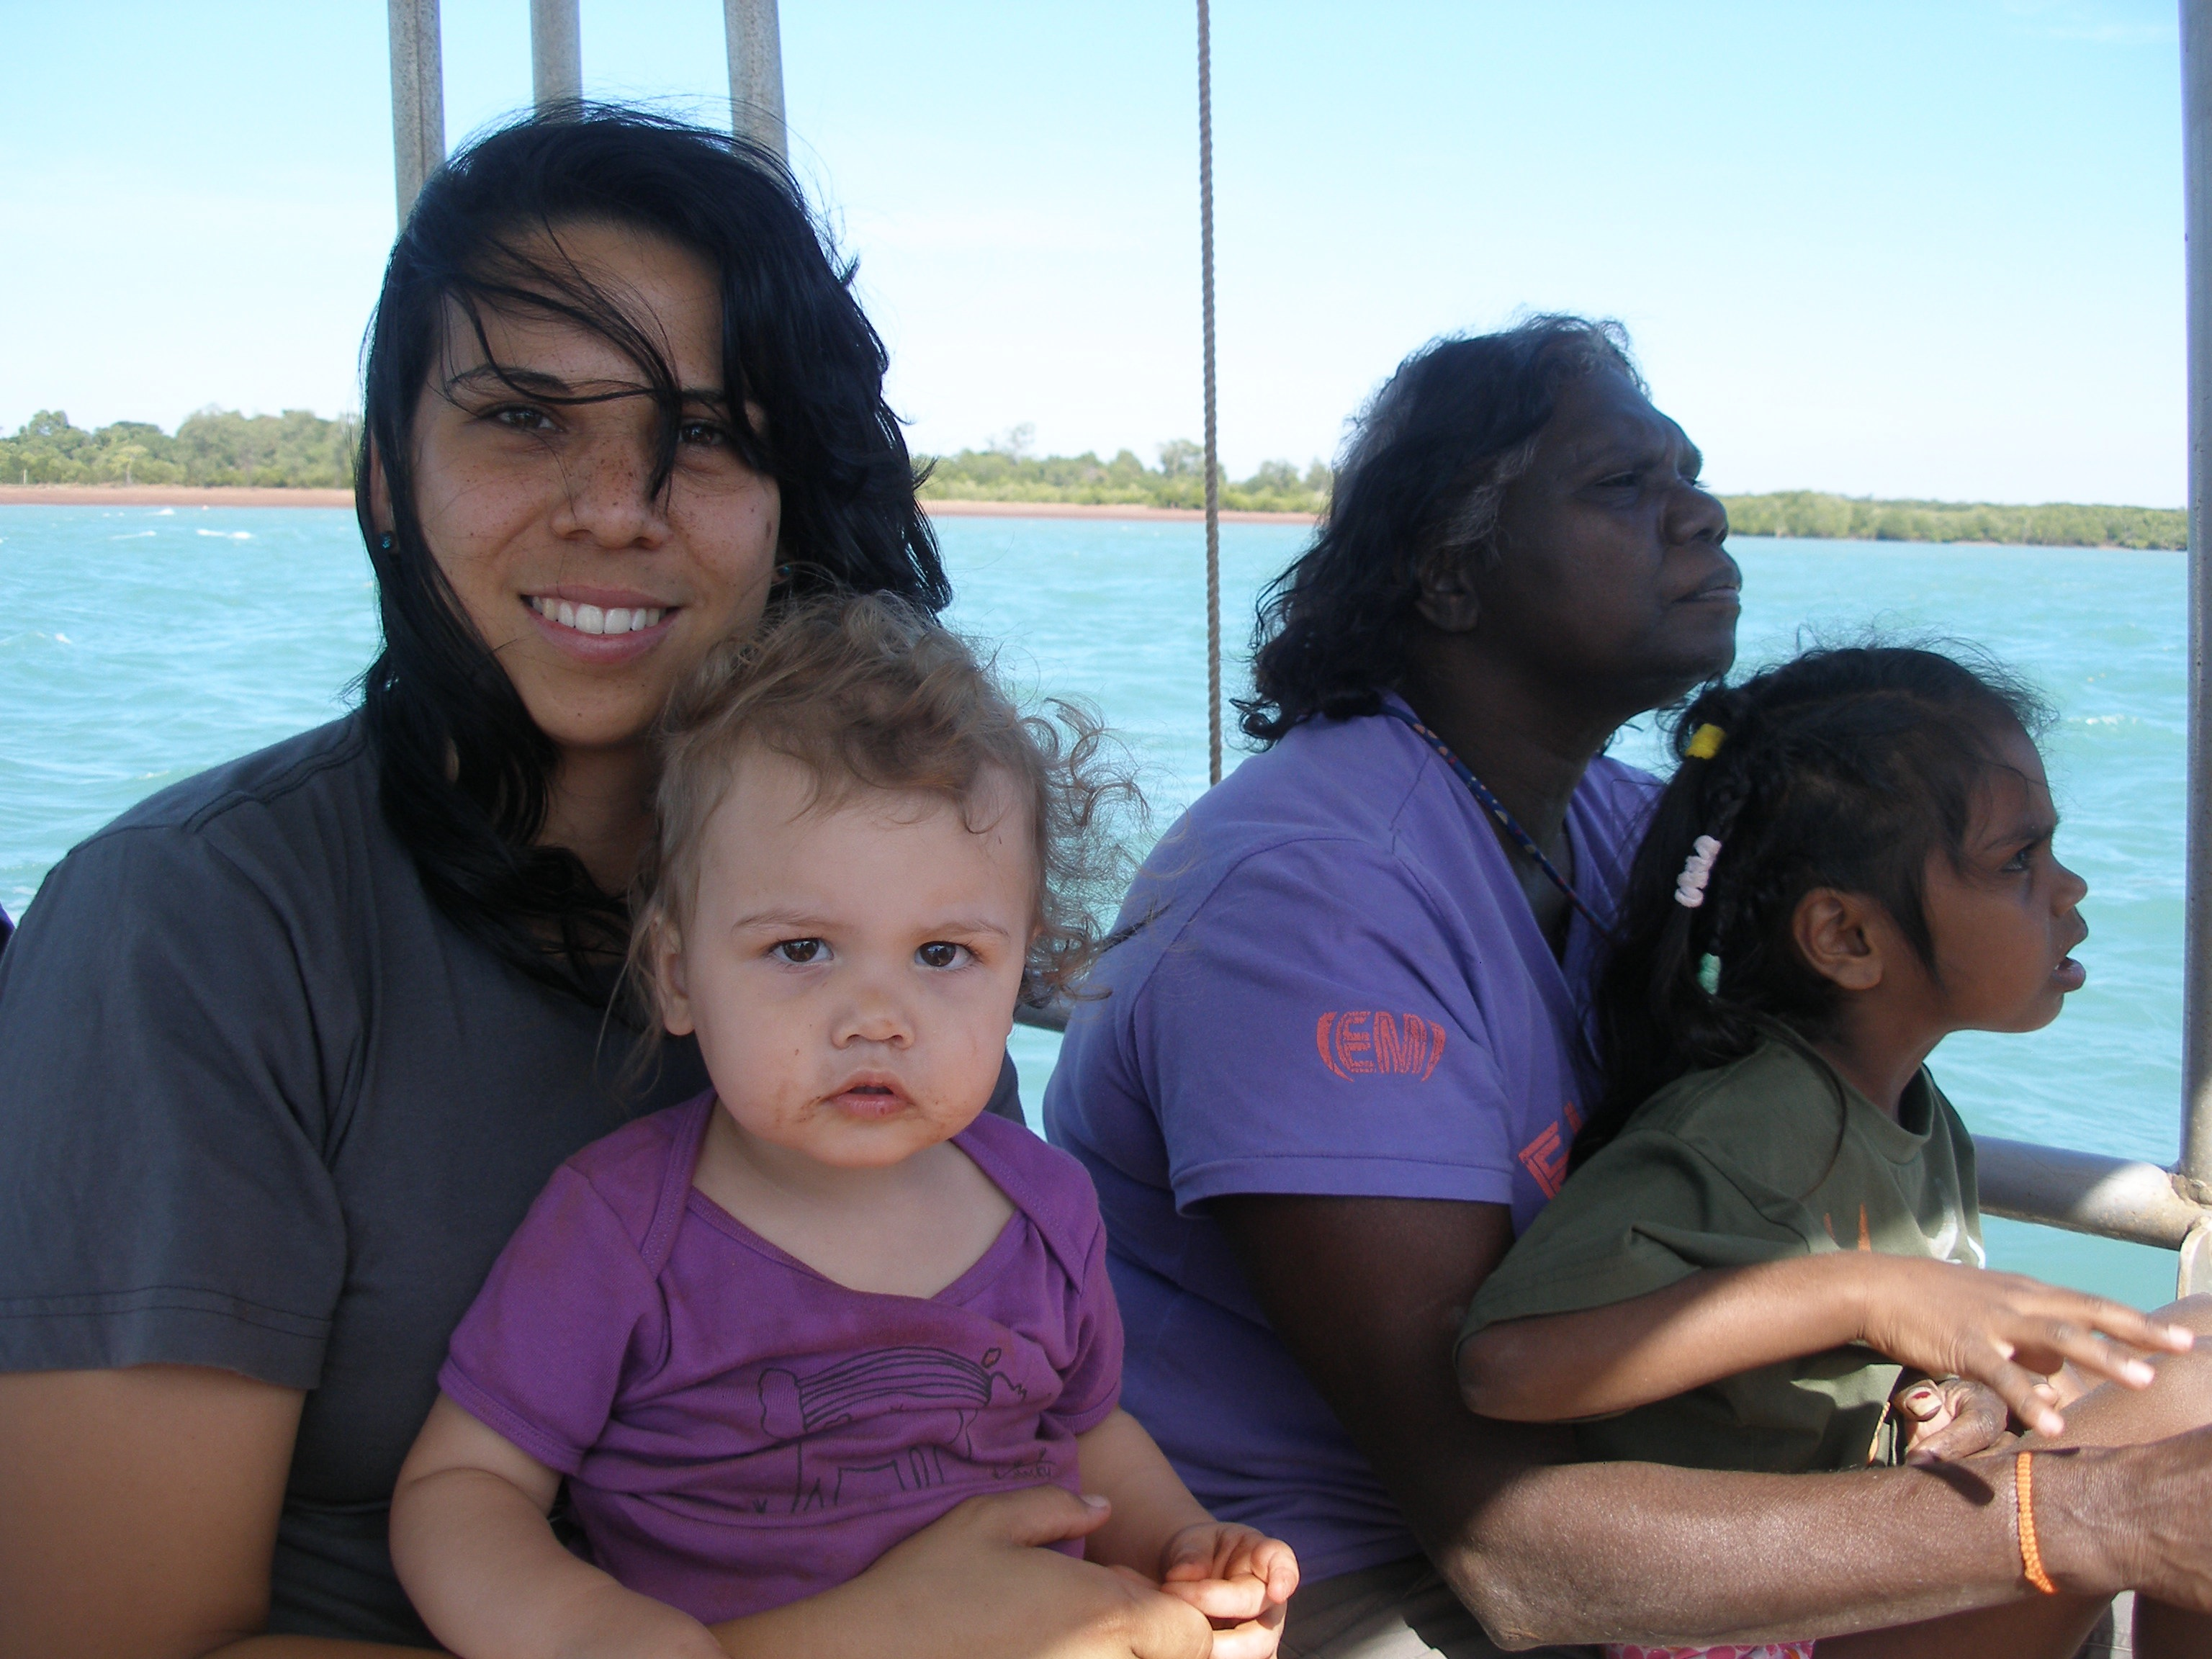
What have been the outcomes for us
(community members, ARC, Families)

Slide 13
Outcomes for evaluation team members
Built confidence in ourselves
Learnt how gather information and evaluate programs
We developed and run the data collection workshops
We get more respect
We feel we are making a valuable contribution to the community
We see ourselves as valued members of the community and the program
It has led to new jobs or roles for all of us here at the conference
Notes:
(Narelle and Stacey helped out by everyone else ) (5 mins)
Built confidence in ourselves – our own skills
Learnt about how to do evaluation, how gather information and evaluate programs
We developed and run the data collection workshops
People in the community see us as more professional
We get more respect from Service providers and community members.
We feel we are making a valuable contribution to the community
We see ourselves as valued members of the community and the program
It has led to new jobs or roles for all of us here at the conference
Examples
Narelle has moved from chair of the committee to being employed by ARC
Therese employed as Nimarra worker and now coordinator
It has given Nimarra workers a better understanding of the Activities and led to us being more involved in the Programs

Slide 14
Outcomes for committees
Being involved in evaluation
Shows committee members what to look for in a good program
Helps committee members make decisions about:
which programs to support
what changes need to be made to improve programs
Notes:
Teresita and Joan
Being involved in the evaluation and getting regular evaluation information:
Shows committee members what to look for in a good program
Has shown us know what a good program looks like
Has strengthened the capacity of the C4C local committee members to make decisions about which programs to support and what changes need to be made to improve programs
Example:
When evaluation showed that bush camps worked well, the Committee decided to put more funding into them
Committee decided to provide additional funding for FAST program in a suburb that had no support

Slide 15
Outcomes for community
Gives people a much better knowledge of what the programs delivered in their community:
aim to achieve
what they should be doing
Lets people hear stories of successes and failures
Gives community members influence over the programs run by external agencies
Ensures that programs benefit the community
Notes:
(Therese and Teresita) (5 mins)

Slide 16
Outcomes for families and children
As a result of the regular and open evaluation activities participants :
feel valued
They have been invited to have their say about their programs
are kept in the loop
we provide get regular feedback about the evaluation
are starting to own the programs
(e.g. organising and running fun days, camps)
Notes:
(Teresita), Tash (2 mins)
As a result of the regular and open evaluation activities:
Families feel valued. They have been invited to have their say about their programs
(e.g of PFC mum saying that it was good to have a chance to have a say)
families are kept in the loop as we provide get regular feedback about the evaluation
families are starting to own the programs
(e.g. organising fun days, camps)
the strong women managed most activities at the bush camps, Nimarra workers such as Ron took boys hunting
Aim is that tThe ongoing evaluation leads to better programs

Slide 17
Outcomes for families and children

Slide 18
Outcomes for the Red Cross and the C4C Program
Building evaluation capacity has added value to the C4C Program.
It has enabled the ARCNT to ‘give back’ to communities:
To invest in the community
To employ local people
The evaluation is more robust because key community people, young mums are asking the questions
Nimarra workers have improved their knowledge about the C4C programs and their knowledge of the programs helped the evaluation
Notes:
(Rachel and Joan) (5 mins)
Building evaluation capacity has added value to the C4C Program. It has enabled the ARCNT to ‘give back’ to communities:
To invest in the community
To employ local people
The evaluation is more robust because key community people, young mums are asking the questions
The evaluators are local people who can put themselves in the “shoes of the community” better than outside evaluators could
Nimarra workers have improved their knowledge about the C4C programs and their knowledge of the programs helped the evaluation

Slide 19
Thanks for listening
Any questions or comments?

